Slide 1
[6030] 支援BLE廣播配網
SW MAC team

Slide 2
需求
前線FAE訪查客戶在BLE配網的需要, 整理出兩個小點:
ACL配網: BLE 需要連線，需要BLE stack (GATT/GAP....profile)
廣播配網: 無須連線，只需要廣播/SCAN。

Slide 3
配网（ADV）
DUT
PHONE
ADV：AP SSID/PSW
Scanner
Legacy ADV
DUT
PHONE
Legacy ADV
Scanner
ADV：STA Status

Slide 4
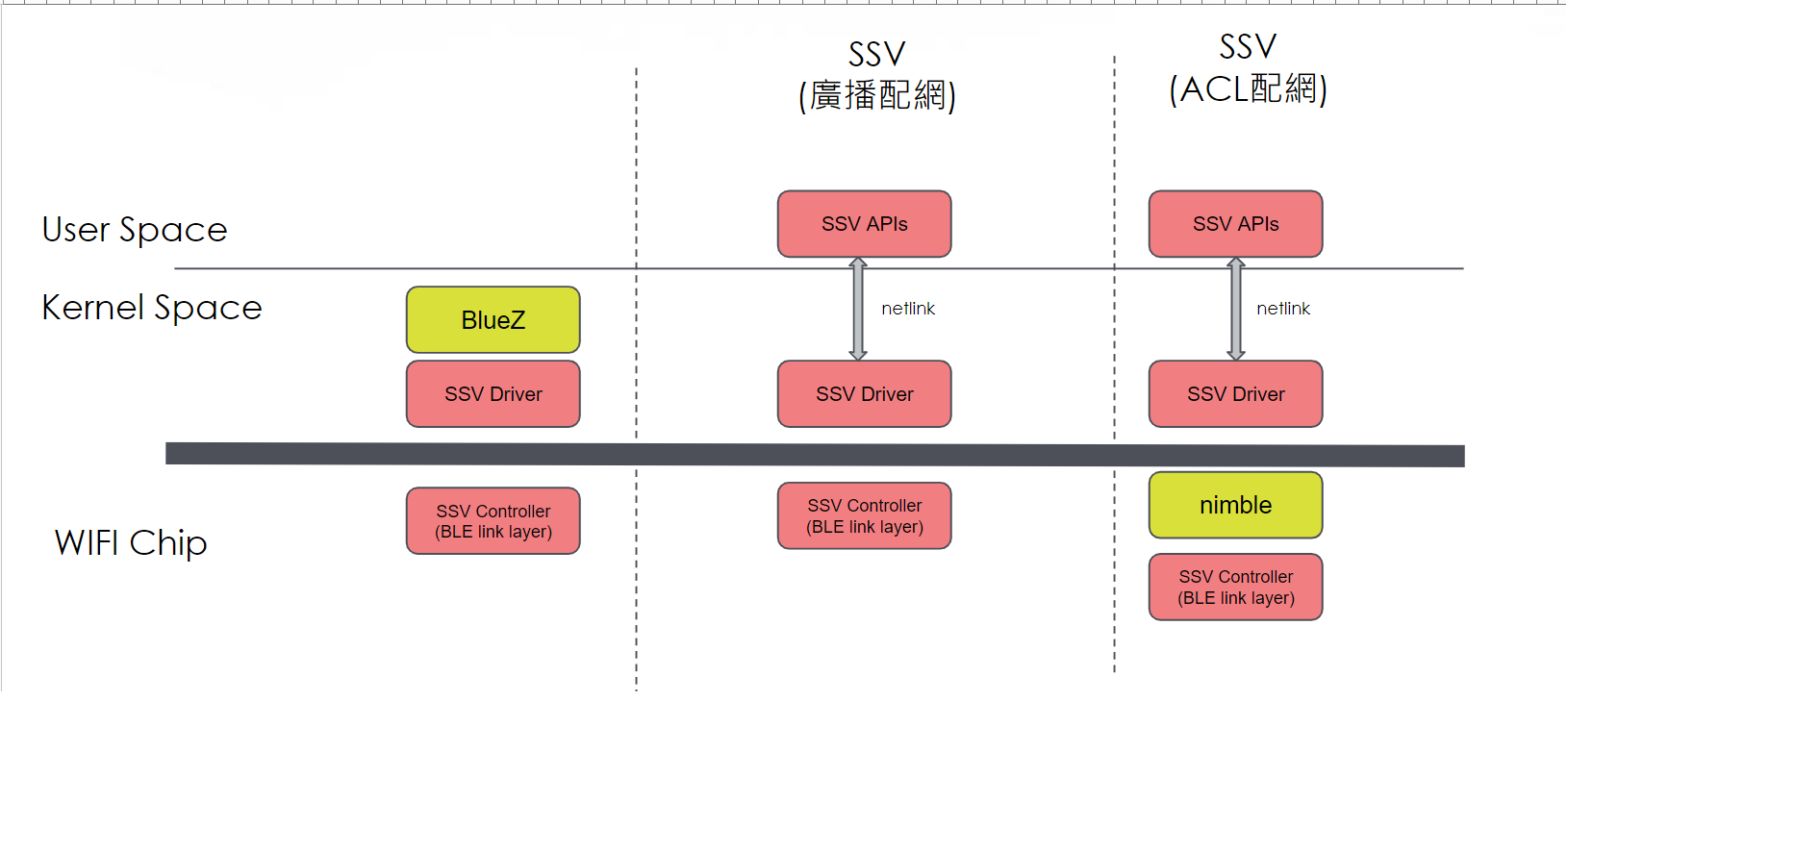
目的
由於廣播/scan無需BLE stack，直接對controller (Link Layer)發出HCI cmd命令它工作，希望藉由ssv6x5x-sw_ble.bin，但不需要Linux BlueZ協助下，完成我們的目標。

Slide 5
Host driver啟動BLE收發app data
在<ssvdriver folder>/目錄下
編輯config.mak, 打開compiler flag, (新增CONFIG定義BLE_USE_LL_ONLY)
編譯driver
修改ssv6x5x-wifi.cfg使用BLE firmware(ssv6x5x-sw_ble.bin)
載入driver
## NIMBLE使用((注意与BLE的使用为2选1)) ## 使用ssv6x5x-sw_nimble.bin #ccflags-y += -DCONFIG_NIMBLE ## BLE HCI usage (注意与NIMBLE的使用为2选1) ## 使用ssv6x5x-sw_ble.bin CONFIG_BLE ?= y ccflags-$(CONFIG_BLE) += -DCONFIG_BLE ## BLE使用application收發data (需同時打開CONFIG_BLE與CONFIG_BLE_HCI_OVER_HWIF方能使用) CONFIG_BLE_USE_LL_ONLY ?= y ccflags-$(CONFIG_BLE_USE_LL_ONLY) += -DBLE_USE_LL_ONLY
# make
################################################################################ # Firmware setting # # Priority.1 insmod parameter "cfgfirmwarepath" (insmod的時候帶入) # Priority.2 firmware_path (在下面設定) # Priority.3 default firmware (前兩個都沒設定會load firmware header) # ################################################################################ #firmware_path = /home/xxx/xxxx/image/ firmware_path = /home/ssv/work/svn/host/FMAC/branch/L.FWB.23Q1.0000.00/image/ ################################################################################ # Firmware name # # 若有設定firmware path的話才有用, 內部預設firmware name使用"ssv6x5x-sw.bin" # ################################################################################ #firmware_name = ssv6x5x-sw.bin firmware_name = ssv6x5x-sw_ble.bin
# ./load.sh

Slide 6
BLE app收發BLE LL的data
在<ssvdriver folder>/tools/ble/ble_app/目錄下
編輯Makefile, 打開compiler flag, (新增BLE_USE_LL_ONLY)
編譯ble_app
執行ble_app, 並CLI command “init=1”
CC = gcc CFLAGS = -c -Wall -fshort-enums CFLAGS += -DBLE_USE_LL_ONLY LDFLAGS =
# ./ble_app ble> init=1 bleinit=1 ble: HCI Reset ble: set event mask ble: set le event mask ble> BLE RX: Command Complete. len=7 BLE RX: Command Complete. len=7 BLE RX: Command Complete. len=7

Slide 7
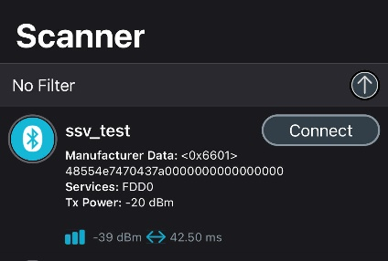
CLI指令範例
init
advert
scanparam
scan
ble> init=1 bleinit=1 ble: HCI Reset ble: set event mask ble: set le event mask ble> BLE RX: Command Complete. len=7 BLE RX: Command Complete. len=7 BLE RX: Command Complete. len=7
(手機應用程式nRF Connect的scan結果)
ble> advert=1,ssv_test bleADV=1,ssv_test ble: set advertising data ble: set scan response data ble: set advertising parameters ble: set advertising enable ble> BLE RX: Command Complete. len=7 BLE RX: Command Complete. len=7 BLE RX: Command Complete. len=7 BLE RX: Command Complete. len=7
ble> scanparams=1,0,0,320,48,1 blesetscanparams=1,0,0,320,48,1 ble: set scan parameter ble> BLE RX: Command Complete. len=7
ble> scan=1 blestartscan=1 ble: scan enable ble> BLE RX: Command Complete. len=7 BLE RX: LE Advertising Report. len=43 BLE RX: LE Advertising Report. len=25 BLE RX: LE Advertising Report. len=34 BLE RX: LE Advertising Report. len=32 BLE RX: LE Advertising Report. len=15 BLE RX: LE Advertising Report. len=30 BLE RX: LE Advertising Report. len=30

Slide 8
實作項目
BLE APP TX:
init:
通知BLE DRV做init
發”HCI Reset”, “set event mask”, “set le event mask”命令
advert:
發”set advertising parameters”, “set advertising data”, “set scan response data”, and “set advertising enable”命令
scanparams
發”set scan parameters”命令
scan
發”scan enable”命令
BLE APP RX
RX packet handler callback => 提供callback註冊, 當有RX packet時呼叫callback處理
BLE DRV
init: 做BLE init, 但不向BlueZ註冊device
TX: 透過netlink打來的TX packet送往firmware
RX: RX packet透過netlink送往APP

Slide 9
BLE LL API
typedef void (*ssv_ble_ll_rx_pkt_cb_t)(uint8_t *, uint32_t); ///< BLE LL RX packet callback type /// Ble scan parameters typedef struct { uint8_t scan_type; /*!< Scan type */ uint8_t own_addr_type; /*!< Owner address type */ uint8_t scan_filter_policy; /*!< Scan filter policy */ uint16_t scan_interval; /*!< Scan interval. This is defined as the time interval from when the Controller started its last LE scan until it begins the subsequent LE scan. Range: 0x0004 to 0x4000 Default: 0x0010 (10 ms) Time = N * 0.625 msec Time Range: 2.5 msec to 10.24 seconds*/ uint16_t scan_window; /*!< Scan window. The duration of the LE scan. LE_Scan_Window shall be less than or equal to LE_Scan_Interval Range: 0x0004 to 0x4000 Default: 0x0010 (10 ms) Time = N * 0.625 msec Time Range: 2.5 msec to 10240 msec */ uint8_t scan_duplicate; /*!< The Scan_Duplicates parameter controls whether the Link Layer should filter out duplicate advertising reports (BLE_SCAN_DUPLICATE_ENABLE) to the Host, or if the Link Layer should generate advertising reports for each packet received */ } ssv_ble_ll_scan_params_t; /// Advertising parameters typedef struct { uint16_t adv_int_min; /*!< Minimum advertising interval for undirected and low duty cycle directed advertising. Range: 0x0020 to 0x4000 Default: N = 0x0800 (1.28 second) Time = N * 0.625 msec Time Range: 20 ms to 10.24 sec */ uint16_t adv_int_max; /*!< Maximum advertising interval for undirected and low duty cycle directed advertising. Range: 0x0020 to 0x4000 Default: N = 0x0800 (1.28 second) Time = N * 0.625 msec Time Range: 20 ms to 10.24 sec Advertising max interval */ uint8_t adv_type; /*!< Advertising type */ uint8_t own_addr_type; /*!< Owner bluetooth device address type */ uint8_t peer_addr[6]; /*!< Peer device bluetooth device address */ uint8_t peer_addr_type; /*!< Peer device bluetooth device address type, only support public address type and random address type */ uint8_t channel_map; /*!< Advertising channel map */ uint8_t adv_filter_policy; /*!< Advertising filter policy */ } ssv_ble_ll_adv_params_t; int32_t ssv_ble_ll_set_rx_pkt_cb(ssv_ble_ll_rx_pkt_cb_t rx_pkt_cb); int32_t ssv_ble_ll_rx_pkt_handler(uint8_t *rx_packet, uint32_t rx_len); int32_t ssv_ble_ll_init(void); int32_t ssv_ble_ll_deinit(void); int32_t ssv_ble_ll_set_advertising_data(uint8_t *raw_data, uint32_t raw_data_len); int32_t ssv_ble_ll_set_scan_rsp_data(uint8_t *raw_data, uint32_t raw_data_len); int32_t ssv_ble_ll_start_advertising(ssv_ble_ll_adv_params_t *adv_params); int32_t ssv_ble_ll_stop_advertising(void); int32_t ssv_ble_ll_set_scan_params(ssv_ble_ll_scan_params_t *scan_params); int32_t ssv_ble_ll_start_scanning(uint32_t duration); int32_t ssv_ble_ll_stop_scanning(void);

Slide 10
注意事項
因著這次ssv_ctl_common.h有更新, 為了避免出錯, 請特別注意驅動與應用程式都需同時編譯更新, 因為兩者都有使用到此header file

Slide 11
Thank you

